Slide 1




Falls Awareness & Prevention
Date: September 2024

Slide 2
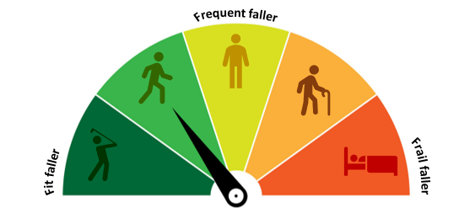
Falls Overview
Falls can be anything from a slip or stumble, to a full stumble and crumble. To some they are nothing more than a bit embarrassing, however to others they can be startling and life changing.
Falls aren’t an inevitable part of getting older but can become more common and can be harder to recover from.
Causes of falls can be:
    Extrinsic (factors external to our body) – trips, environmental hazards, drugs
    Intrinsic (directly related to our body) – muscle weakness, loss of balance, impaired vision, cognitive impairment
    Combination of both
Falls can result in:
    Loss of confidence/increased anxiety
    Isolation
    Reduced function and independence
There’s a lot you can do to reduce the chance of having a fall, even if you’ve had one in the past. By making some small changes, you can reduce your risk of sustaining a fall, make your day-to-day life easier and stay independent for longer.

Slide 3
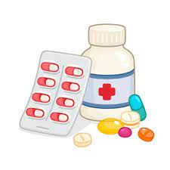
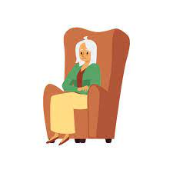
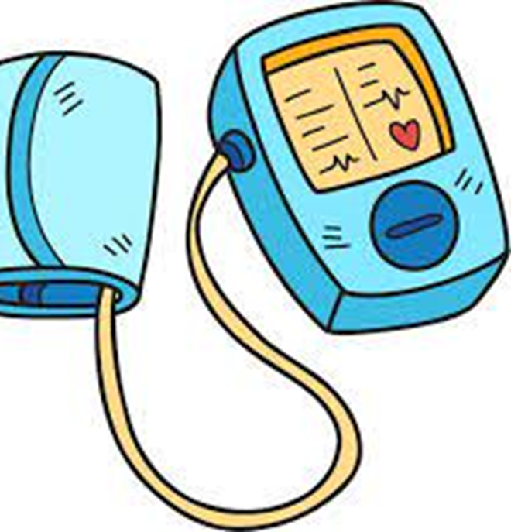
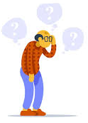
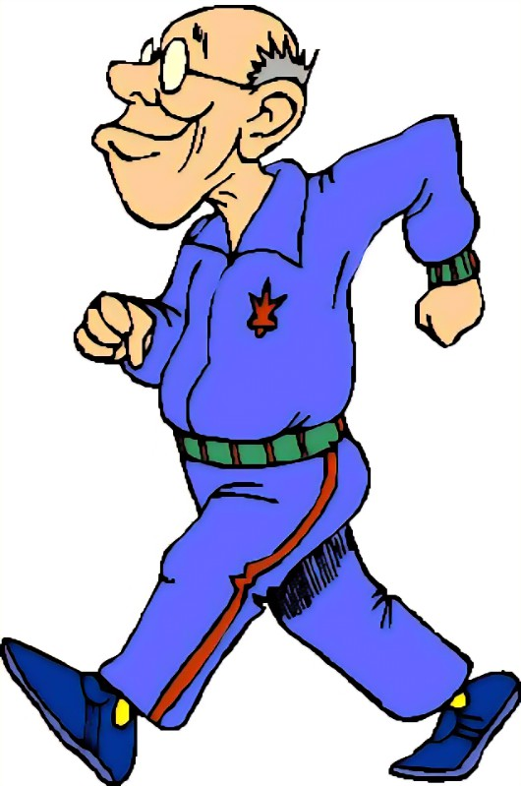
Falls & Dementia
Those with dementia are:
      2-3 times more likely to experience a fall than those living without an impairment
      Are more likely to sustain and take longer to recover from a live changing injury as a result of a fall e.g. hip fracture.
Frequent falls are the most common reason that those living with dementia in the community are moved into 24-hour care environments.
Alzheimer's – the least likely to experience a fall as there are less motor symptoms involved
Vascular dementia - because there are motor components involved these individuals can experience a higher number of falls than Alzheimer's patients.
Why Do Those With Dementia Experience More Falls?
Postural hypotension
Medication
Sedentary lifestyle
Reduced attention and motor planning
Wandering with purpose

Slide 4

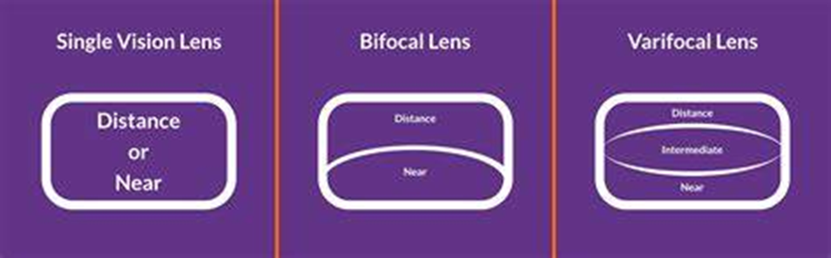
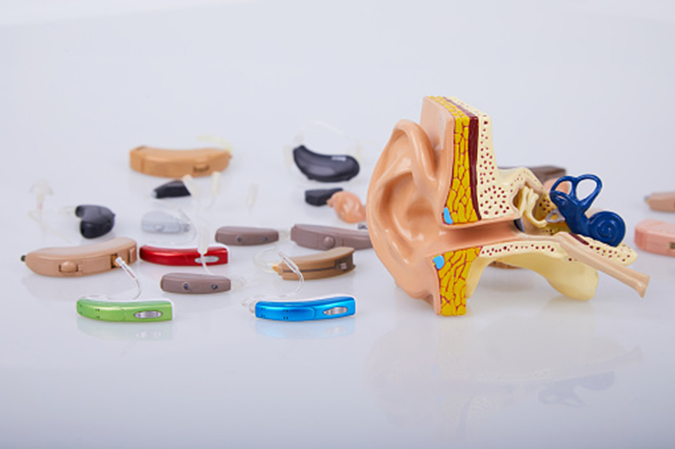

Eyesight & Hearing
Vision and hearing are the main senses we use to learn about and interact with, our environment. Vision changes and hearing loss caused by normal ageing can increase your risk of falling.
Eyesight - helps us see obstacles, see them clearly, and navigate around them
Eyesight reduces as we get older (macular degeneration, cataracts and diabetes), resulting in blurred vision, reduced visual fields, altered depth perception, reduced ability to see in low contrast situations or taking longer to adjust to different lighting
Hearing - can help us identify obstacles we cant see, and control your balance
Hearing loss can affect your balance, making tripping and falling more likely. If you have noticed
a change in your hearing, speak to your GP.

Slide 5
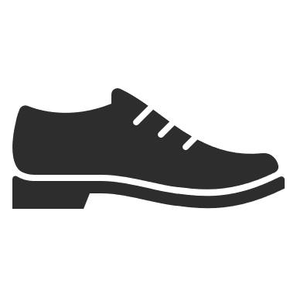
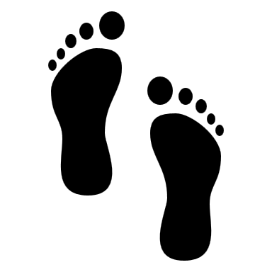
Feet & Footwear
Our feet are important in helping us stay balanced. Looking after your feet can help prevent problems that can cause pain, discomfort and make you unsteady. The 2 main things to consider are:
Footcare
Feet should be washed daily and dried thoroughly (especially between your toes)
Toenails should be trimmed once a week (consider a chiropodist if unable to do yourself)
Skin should be kept smooth and checked for cracks/breaks in the skin
Older people with foot pain walk more slowly and may walk badly. They are less able to balance and coordinate stability.
Those with diabetes should have their feet screened as part of an annual diabetic review.
Footwear
Should fit properly
  shoes should feel safe and secure when walking
  Velcro fastenings are recommended for people that suffer from swelling
Should provide adequate support
  Soft, firm leather shoes with man-made thin sole and low/flat heel with good grip are best
Walking in bare feet or socks can increase risk of slipping.
Slippers should not be worn for long periods, and should have appropriate fastening to keep them on your feet

Slide 6
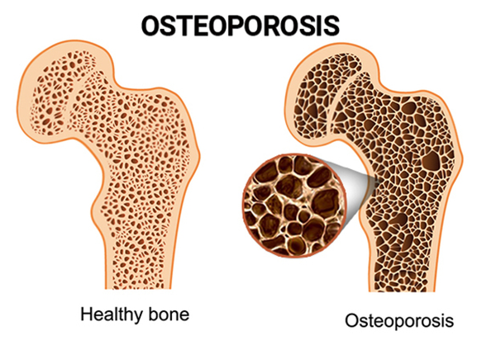
Bone Health
Keeping your bones healthy is important, regardless of age. If your bones are strong, there is less chance of you breaking a bone if you fall. Losing bone density is a normal part of the ageing process., with some people losing it much faster than normal. This can lead to osteoporosis.
Osteoporosis
  About 3 million people in the UK are affected by osteoporosis, with women are more at risk of osteoporosis than men
  Risk factors include RA, family history, low BMI, long term steroid use and long periods of inactivity
  1 in 2 women and 1 in 5 men over 50 will break a bone due to low bone strength from osteoporosis
  Over 500,000 people need hospital treatment every year for fragility fractures (fractures caused by osteoporosis).
Having osteoporosis doesn’t automatically mean that your bones will break (fracture), but it does mean that you’ve a higher chance of breaking a bone if you have a bump or fall.
There are a number of things you can do to make your bones stronger.
  Do weight-bearing exercises
  Eat a well balanced diet rich in calcium, (dairy, green
  leafy vegetables, nuts)
  Increase Vitamin D levels, through diet (oily fish, eggs,
  fortified cereals/bread) or from sunlight
  Limit alcohol
  Stop smoking

Slide 7



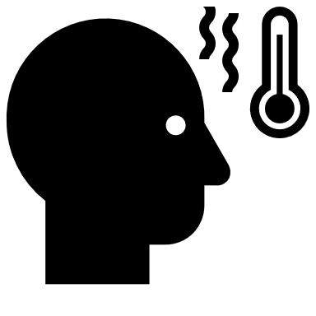


Medication
Medication can play an important role in keeping us healthy, as long as it is appropriate. Medicine use is an ongoing process that needs regularly reviewed and altered.
Polypharmacy (the use of multiple medicines) or the side effects of certain medicines can increase your risk of falling.
Some side effects that increase risk of falling include:
        Dizziness e.g. blood pressure drugs and diuretics
        Drowsiness e.g. sleeping tablets, tranquilizers, antihistamines, anti-emetics, anti-epileptic
        Altered vision
        Difficulty thinking clearly
Things to consider with medication:
WHY HOW STORAGE SIDE EFFECTS OVERCOUNTER MEDS ALCOHOL
People who can review your medications include:
        GP or other prescribers in your GP practice
        Practice pharmacist
        During hospital visits (clinics or hospital admission)

Slide 8
Diet & Hydration
Eating regular, nutritious meals and drinking plenty of non-alcoholic fluids can help to avoid problems that can contribute to a fall.
What can I do?
  eat a varied and balanced diet
  eat regularly, and don’t skip meals (can make you feel dizzy or faint/lightheaded and tired))
  keep hydrated by drinking water and other soft drinks regularly (prevents
  dehydration and urine infections, which can lead to dizziness, low blood
  pressure, confusion and loss of balance)
  keep to the recommended safe levels for drinking alcohol (can affect
  memory, balance, coordination and judgement)
As people get older, they can become less aware that they are thirsty and are becoming dehydrated. Some people who have problems with their bladder and bowels try not to drink much as they are concerned about getting to the toilet on time, though this can make bladder and bowel problems worse.

Slide 9
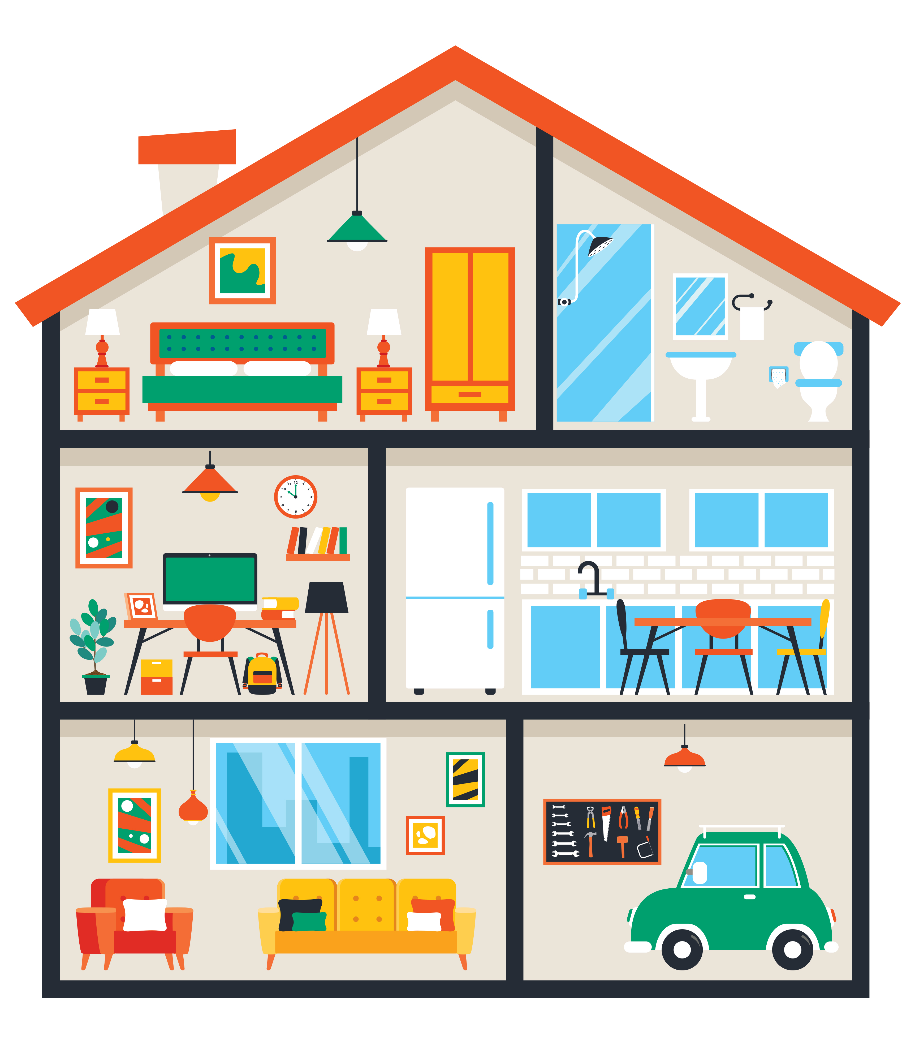
Environment
Over half of all falls happen at home, where we spend much of our time and tend to move around without thinking about our safety. Sometimes even familiar environments can become difficult to get around as we get older.
Falls prevention in and around the home is often described as ‘common sense’, however, it isn’t always easy to recognise the things that can cause trips, slips and falls.
The majority of falls can be prevented by making a few small changes. Some of these are simple changes that you can do yourself, while others require extra support from friends, relatives or a specialist care and repair service.
To make your home safer, consider the following:
    Trip and slip hazards – clutter, cables
    Flooring
    Slippery surfaces
    Lighting
    Furniture and furnishings
    Colour and contrast
    Storing and carrying items
    Pets
    Equipment

Slide 10
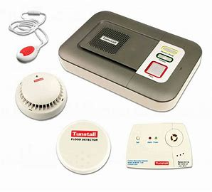
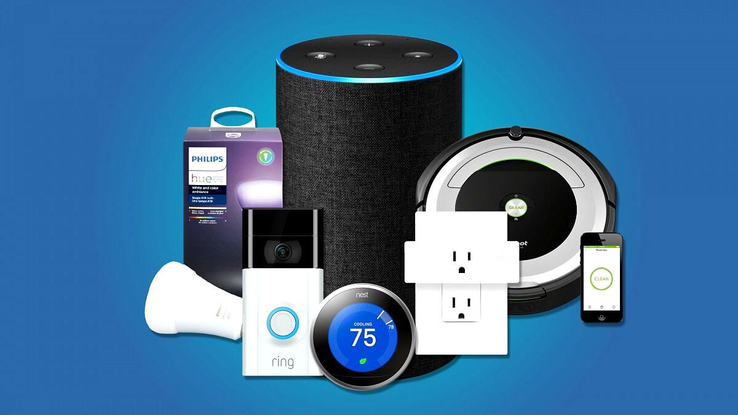
Technology
Technology enabled care is the use of different technologies to improve a person's outcomes. Telecare and Consumer technology are used to support people to live safely and independently in their own home and can play an important role for those people at risk of falling.
Telecare
Involves provision of devices that can either be linked to a community alarm box that goes through to an alarm-receiving centre which operates 24/7, or stand-alone which links to a pager that is held by another member of the household. Devices include:
Community alarm
Automatic falls detector
Bed or chair sensor
NB. Telecare is provided by the local authority and incurs a regular charge.
Smart TEC (consumer technology)
    Used creatively, these devices can assist people to remain as active and independent as possible, may prevent falls and help people communicate with their friends and family. Devices include:
    Lighting
    Smart speakers
    Smart watches
    Medication reminders
    Lifestyle monitoring

Slide 11
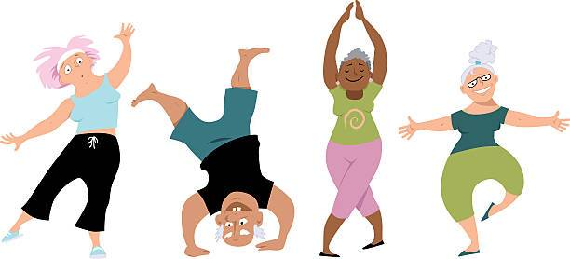
Keeping Active
Keeping active and taking regular exercise has many benefits, even if you’ve been inactive for years. At any age, regular exercise helps to strengthen muscles and can improve your balance, stamina and flexibility, reducing your risk of falling and experiencing a serious injury if you do. Active people are also more likely to have better mood, be less anxious, have better memory, sleep better and have more social contacts.
After a fall, many people become less active and stop going out. This can make matters worse – you can lose confidence and become weaker and more unsteady on your feet. If you’ve had a fall, it’s even more important that you stay active, and do this safely.
What can I do?
  Be active every day – sit less, move more!
  Aim for 150 minutes of physical activity each week, with daily activities such as walking, stair climbing, and housework all contributing
  Muscle-strengthening and balance exercises twice a week (you need to keep doing falls prevention exercises long term for them to be effective)
In 3 months, 65+ year olds can rejuvenate 20 years of lost strength!

Slide 12

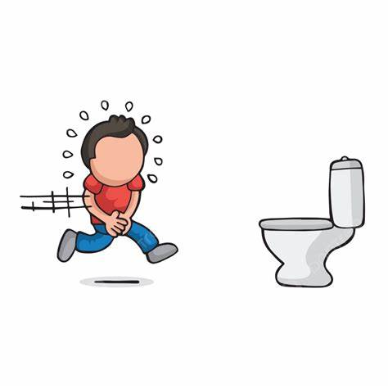
Aids & Equipment
As we age, changes in our body can affect the way we move, which can contribute to your risk of falling, increasing the likelihood of a trip or loss of balance.
If you require support when moving around, such as a walking aid, or equipment to support with functional tasks, always ensure they are:
  Matched to your needs
  Fitted especially for you
  Regularly maintained, serviced and repaired
  Safe to use in your home environment
Continence
Incontinence can often lead to increased falls, due to:
  Urgency causing people to rush and be less safety conscious
  Alter walking patterns to avoid leaking
  Social isolation, resulting in deconditioning
  Increased voiding overnight in dark environments or when you are drowsy
  Reduced fluid intake, resulting in dehydration and exacerbation of urinary incontinence symptoms

Slide 13
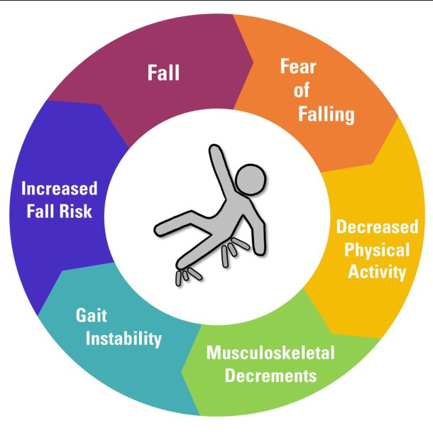
Fear of Falling & Anxiety Management
Having fears about falling in later life is very common and often distressing. It can limit your life in many ways
  leave you feeling shaken up and more cautious, act in ways that help you feel safer
  make you feel like you don’t have any control in how you feel and that nothing can be done to change your situation
  may be embarrassed or fear losing your independence if you tell someone your concerns
  might stop doing things and lose confidence in your abilities, making life difficult/less enjoyable and lead to low mood and depression
A mild level of anxiety is very common and can often be seen as a normal part of life. However, some people have very strong and constant anxiety and panicky feelings about falling. Dealing with anxiety can help to improve your mobility, confidence and quality of life.
What can I do?
    identify why you’re falling and take action to reduce risk
    make a plan for getting help if you should fall
    talk to someone about your fears and anxiety
    set small achievable goals to help you feel more confident again
    challenge any negative thoughts
    keep active
    practice relaxation techniques

Slide 14
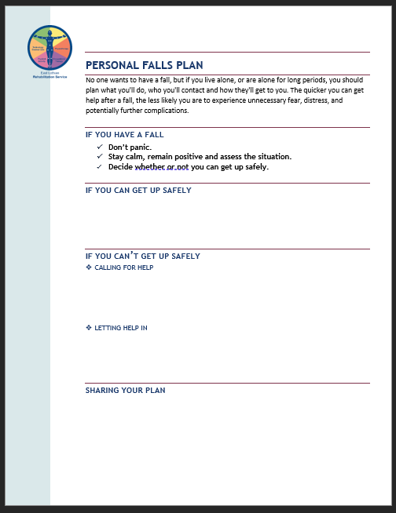
Falls Plan
Falling can be a frightening experience. If we prepare and have a plan of what we could do should we have a fall, we can reduce the fear. Having a ‘falls plan’ can help you manage any anxiety or panic if you do have a fall.
What plan do you currently have in place should you or your loved one fall at home or in the garden?
Need to consider two scenarios.
      Scenario 1
      If you can get yourself up – how do you do it?
      Scenario 2
      If you can’t get yourself up – how will you get help?
Remember to always discuss and share your falls plan with carers and
loved ones!

Slide 15
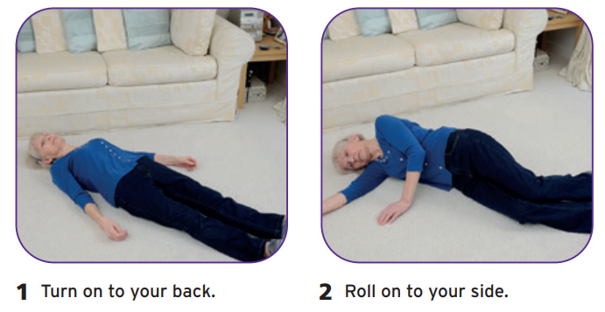
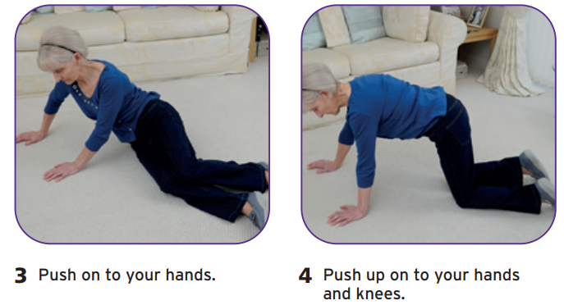
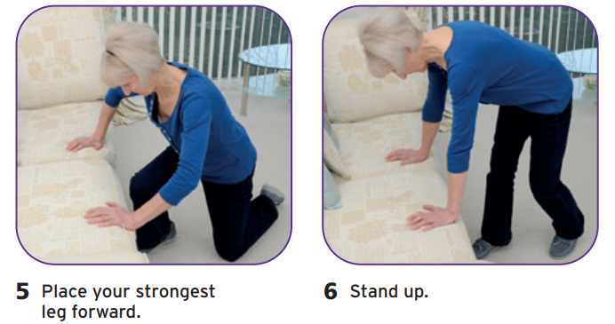
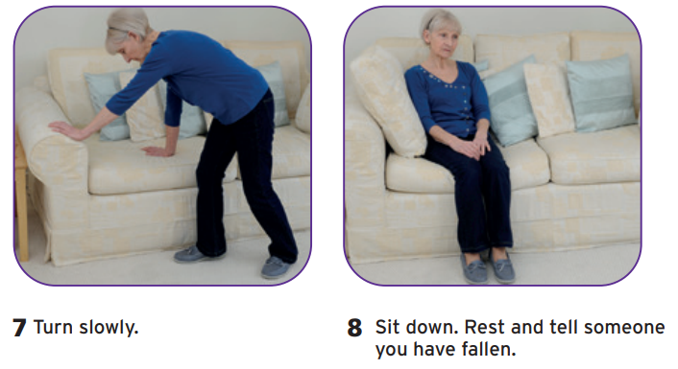
How to safely get off the floor

Slide 16
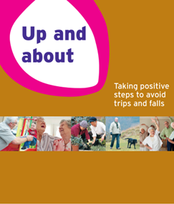
Helpful Resources
Falls Support – NHS Lothian | Our Services
Preventing falls | NHS inform
Slips, trips and falls | Access to a Better Life in East Lothian | East Lothian Council

Slide 17
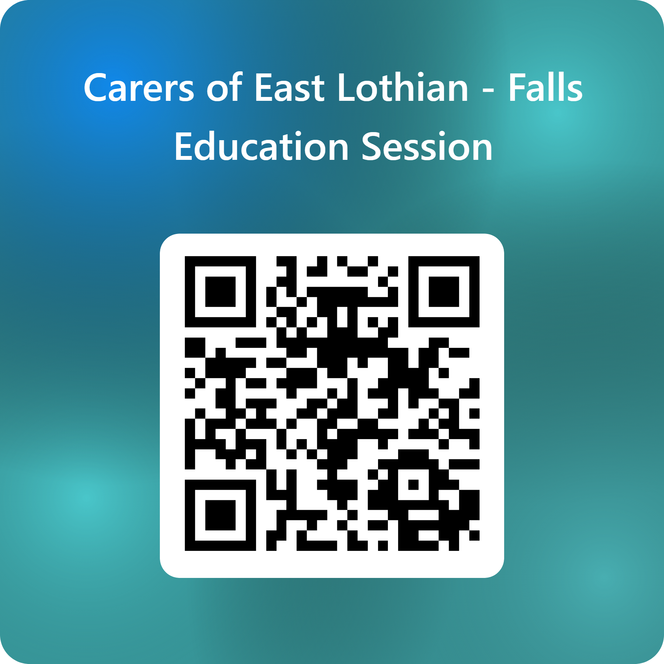
Feedback
Notes:
https://forms.office.com/e/D1xWFkJ7KR

